Slide 2
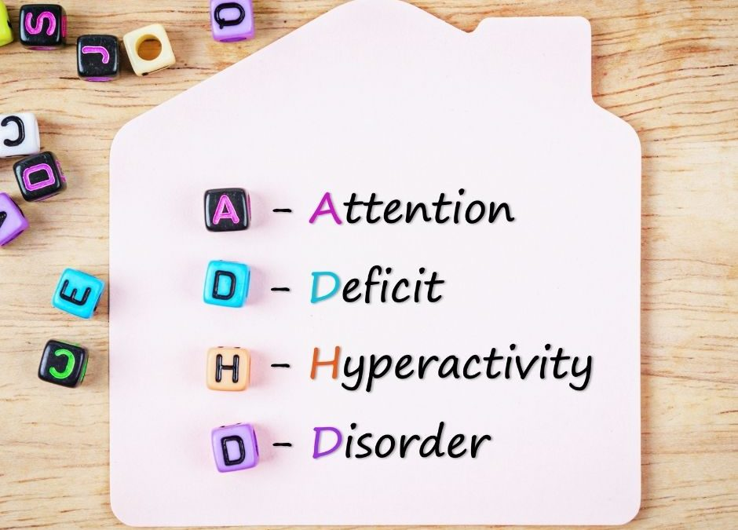
Sanaz Norouzi MD. Assistant Professor of Child & Adolescent Psychiatry Tabriz University of Medical Sciences

Slide 4
ADHD Why Do You Need to Know?
ADHD:
Is common
Can be serious
Can persist
Is stigmatizing
Is treatable
Notes:
ADHD is common in all cultures
ADHD can be serious: untreated it can lead to educational failure, accidents and unfair harsh punishments that may worsen the behaviour and outcome.
Severe ADHD can persist into adulthood with risk of : marriage breakdowns, unemployment, accidents, other psychiatric disorders
ADHD is stigmatizing: Patients or their families may be blamed for the bahaviours, suffering social exclusion
ADHD is treatable with several evidence
based treatments

Slide 5
Developmental Impact of ADHD
Academic problems
Difficulty with social interactions
Self-esteem issues
Legal issues, smoking and injury
Occupational failure
Self-esteem issues
Relationship problems
Injury/accidents
Substance abuse
Behavioural
disturbance
Pre-school Adolescent Adult
School-age College-age
Behavioural disturbance
Academic problems
Difficulty with social interactions
Self-esteem issues
Academic failure
Occupational difficulties
Self-esteem issues
Substance abuse
Injury/accidents
Notes:
Over 60% of childhood ADHD continues into adulthood¹.
1. Baren M. ADHD in adolescents: Will you know it when you see it? Contemporary Pediatrics 2002; 19: 124-141.

Slide 6
EPIDEMIOLOGY

Slide 7
The change to the DSM-IV diagnostic system with the creation of the three subtypes increased the prevalence of ADHD from 3% to 5% (DSM-III-R) to about 12%

Slide 8
Diagnostic Criteria for ADHD (DSM-5)
Inattention (6 or more)
Hyperactivity-impulsivity (6 or more)
Several symptoms were present before age 12 years.
Several symptoms are present in two or more settings.

Slide 9
Clinically significant impairment in social, academic, or occupational functioning.
Symptoms do not occur exclusively during the course of psychotic disorders and are not better explained by another mental disorder.

Slide 10
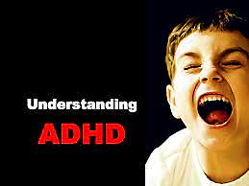
Symptoms of ADHD

Slide 11
Symptoms of ADHD
Inattention
Hyperactivity
Impulsivity
Notes:
The core symptoms of ADHD as defined in the DSM-IV and ICD-10 diagnostic criteria are inattention, impulsivity and hyperactivity
The differences between these diagnostic criteria will be outlined later.

